Slide 1
GSM BASED HOME AUTOMATION USING ARDUINO DANIEL PATRICK PUNZALAN JESUS LUIGI SISON

Slide 2
CHAPTER 1 INTRODUCTION

Slide 3
I N T R O D U C T I O N
Home automation concept
There is already existing products and components that aid automation of home appliances.
GSM Based Home Automation using Arduino as a switch box
Notes:
is the concept of controlling appliances into an automation system
with the continuous of technology advancements…
switchbox device can control appliances by sending SMS through gsm with arduino

Slide 4
STATEMENT OF THE PROBLEM
How to Design a system that will automatically switch (on & off) an appliance.
How to Design a switch box that can be controlled remotely using a mobile phone.
How to Integrate an existing web application for home appliance control.
How to Design other features for the home automation system.
Notes:
the aim of this project is to develop the system
the project pursues to answer the ff:....

Slide 5
SIGNIFICANCE OF THE STUDY
Households/ home owners.
Future researchers.
Notes:
manage energy consumption and tend to forget to turn ON or OFF their appliance.
reference for future studies in creating and developing the similar technology used that can either enhance, replace or integrate with the proposed system.

Slide 6
SCOPE AND LIMITATIONS
Automation of home appliances through SMS.
Limited in the use of only a GSM.
SIM Card
No security measures
Arduino environment
Notes:
If the sim card is misplaced or missing, the system stops
No security measure is added for the monitoring

Slide 7
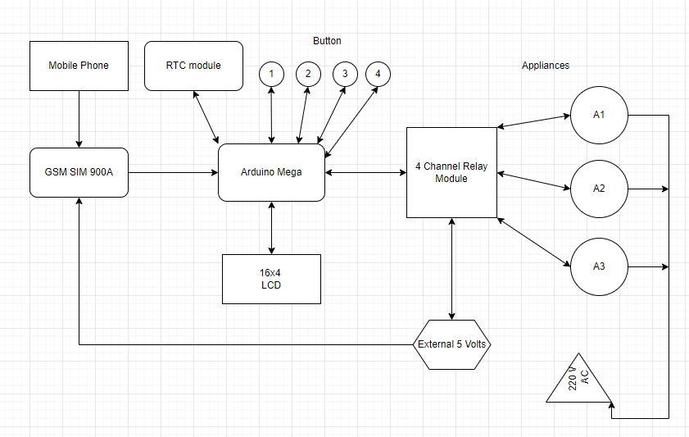
PROPOSED SYSTEM

Slide 8
CHAPTER 3 RESEARCH METHODOLOGY

Slide 9
HARDWARE & FIRMWARE DEVELOPMENT
Hardware:
Arduino Mega
GSM Module
Switchbox
Relay
RTC Module
LCD Module
Firmware:
Arduino IDE
App Inventor

Slide 10
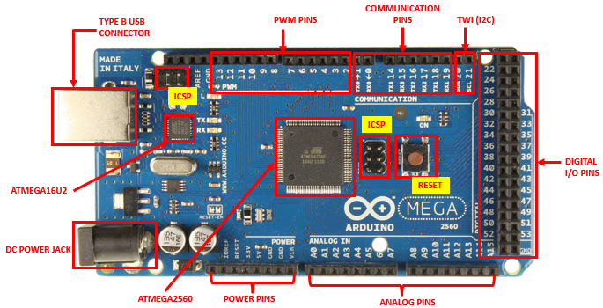
ARDUINO MEGA
Notes:
ATmega2560 microcontroller
features 54 digital I/O pins, 15 PWM outputs, 16 analog inputs, 4 UARTs,
USB port, power jack, and reset button.
It includes all components required to support the microcontroller.
With the use of a USB cable, you can connect it to a computer or power it with an AC-to-DC adapter or battery to run.

Slide 11
ARDUINO MEGA
ATMEGA2560 & ATMEGA16U2
Power Pins
54 Digital Pins
16 Analog Pins
Communication Pins
15 PWM
TWI (I2C)
ICSP
Notes:
PWM: a method of producing analog outcomes through the use of digital techniques.
I2C: for data transferring
ICSP: An Arduino can be programmed and booted from a different device using the ICSP port.

Slide 12
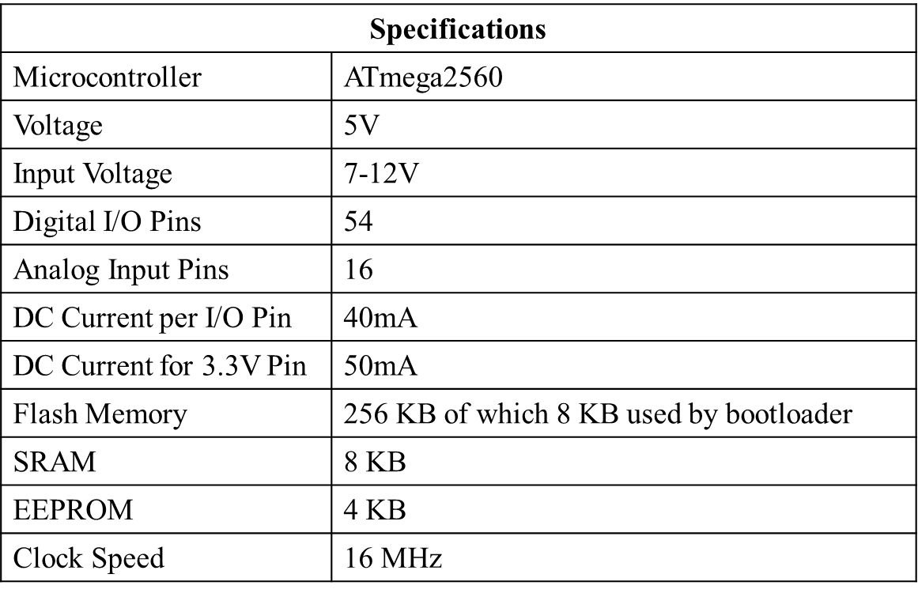
ARDUINO MEGA

Slide 13
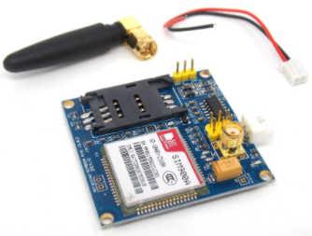
HARDWARE DEVELOPMENT
SIM900A

Slide 14
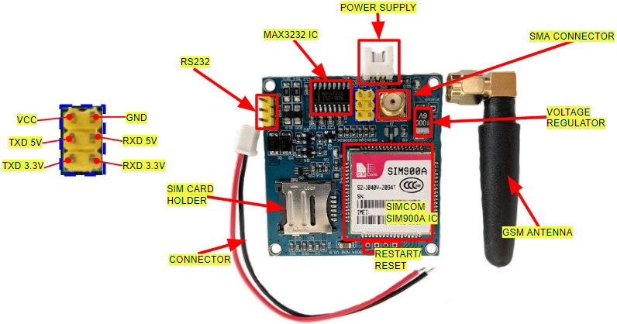

Slide 15
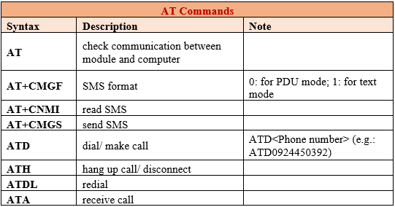
SIM900A (GSM MODULE)
AT Commands
Notes:
The frequency bands and baud rate can be set and configured respectively through the AT commands. It is used to control the modems where AT stands for Attention. These sets of commands have four classifications: Test, Read, Set, and Execution. Some of the notable AT commands are listed in the table

Slide 16
SIM900A (GSM MODULE)
AT Commands
AT+CMGF=1
AT+CNMI=1,2,0,0,0
AT+CMGL=\"REC UNREAD\"
AT+CMGDA=\"DEL ALL\"
AT+CMGS=\"+639123456789\"\
Notes:
SMS format
response of the GSMmodem
reading unread messages
del message to save memory
send an SMS registered

Slide 17
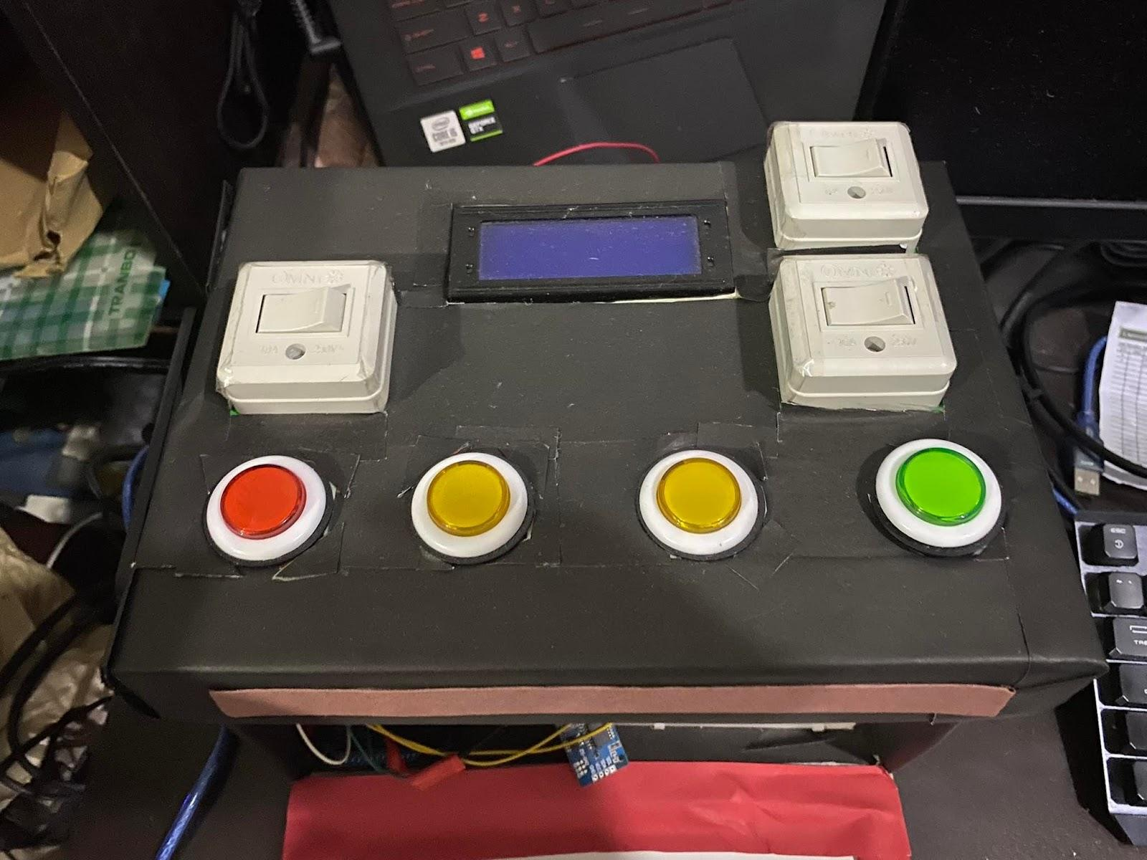
SWITCHBOX

Slide 18
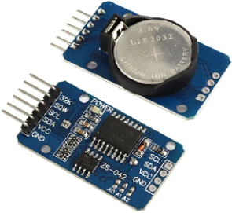
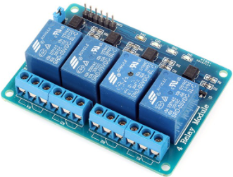
RELAY
RTC MODULE
Notes:
-serve as the voltage control of appliances
-stores the current time and date

Slide 19
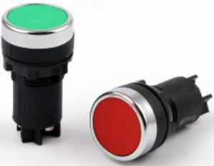
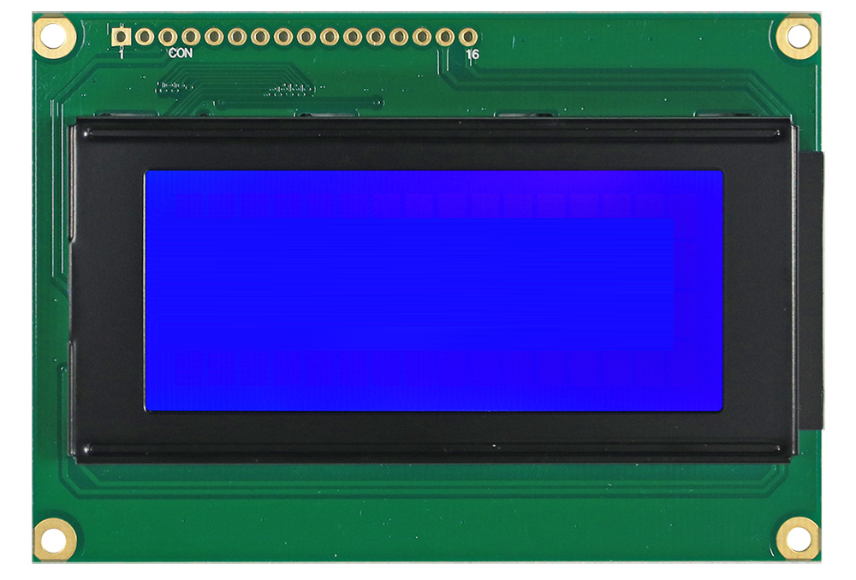
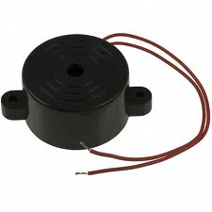
LCD MODULE
PUSH BUTTON SWITCH
BUZZER

Slide 20
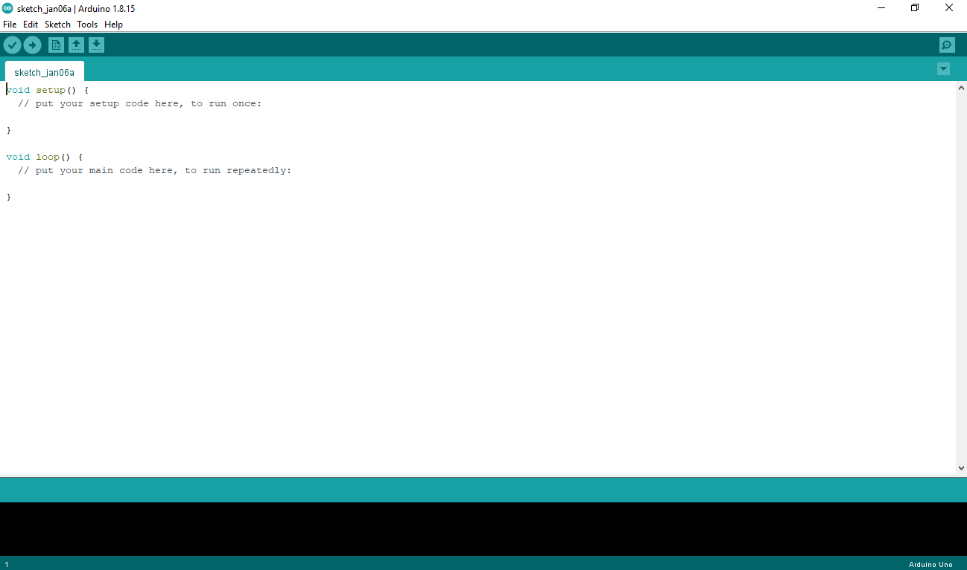
FIRMWARE DEVELOPMENT
ARDUINO IDE
Arduino IDE
Notes:
-since arduino mega board is used, the ide is needed to write the code of the

Slide 21
FIRMWARE DEVELOPMENT
ARDUINO IDE
Arduino IDE
Libraries
SoftwareSerial
DS3231
LiquidCrystal_I2C
EEPROM
Wire
Notes:
-since arduino mega board is used, the ide is needed to write the code of the

Slide 22
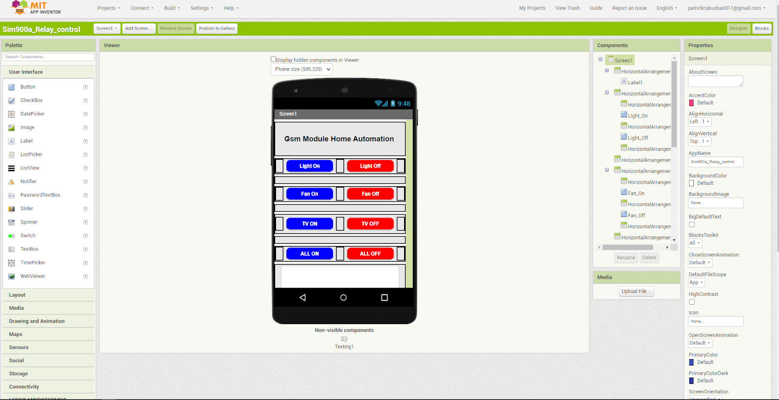
FIRMWARE DEVELOPMENT
APP INVENTOR

Slide 23
PROGRAM FLOWCHART

Slide 24
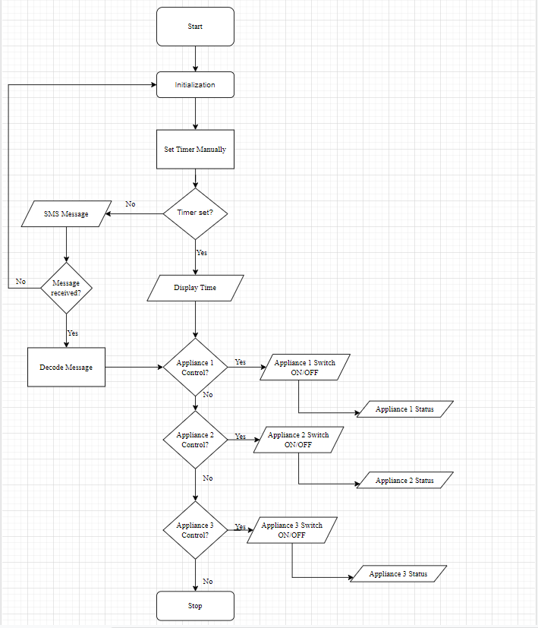

Slide 25
TESTING OF THE PROJECT

Slide 26
TESTING OF THE PROJECT
Gathering and Testing of Appliances and Components
Open source libraries
Schematic diagram
Arduino IDE connection
Simulation of the prototype
Project Maintenance

Slide 27
SCHEMATIC DIAGRAM

Slide 28
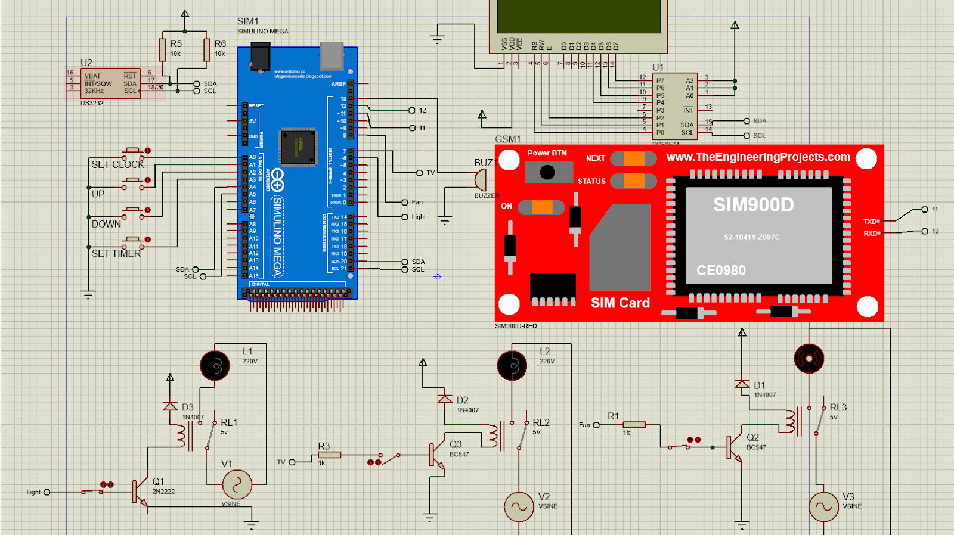

Slide 29
CHAPTER 4 PRESENTATION AND ANALYSIS OF DATA

Slide 30
PRESENTATION AND ANALYSIS OF DATA
Automatic Switching of Appliance
Remote Controlling Switch Box using Mobile Phone
Integrate Web Application for Home Appliance Control
Other Features of the System

Slide 31
AUTOMATIC SWITCHING OF APPLIANCE

Slide 32
AUTOMATIC SWITCHING OF APPLIANCE
Sending a SMS Message
Feedback Messaging
The user will receive a message after sending an SMS to switch an appliance. This allows the user to be informed of the appliance status.

Slide 33
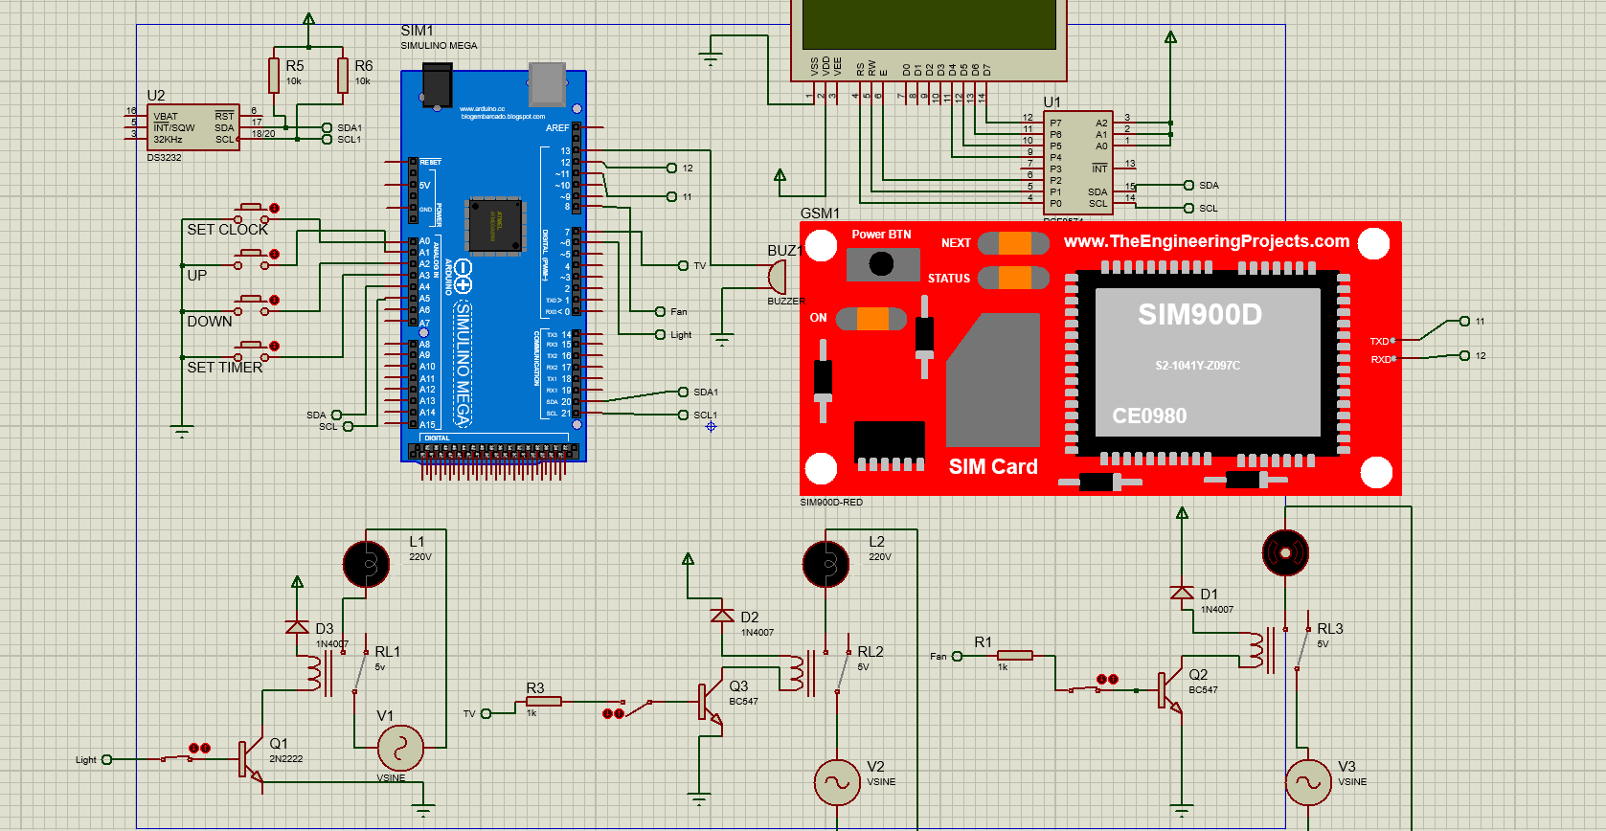

Slide 34
REMOTE CONTROLLING SWITCHBOX USING MOBILE PHONE

Slide 35
REMOTE CONTROLLING SWITCHBOX USING MOBILE PHONE
Sending an SMS to the switchbox.
The process of receiving to the switchbox is the GSM module Decodes the SMS from Mobile Phone for the user to control the appliances.

Slide 36
REMOTE CONTROLLING SWITCHBOX USING MOBILE PHONE
The message must contain with ‘ON#(the ‘#’ appliance number want to control)’ while the ‘OFF#(the’#’ Appliance number wants to control)’ to control the appliances the switching delay depends on the signal.
Block Diagram of GSM Control Appliances

Slide 37
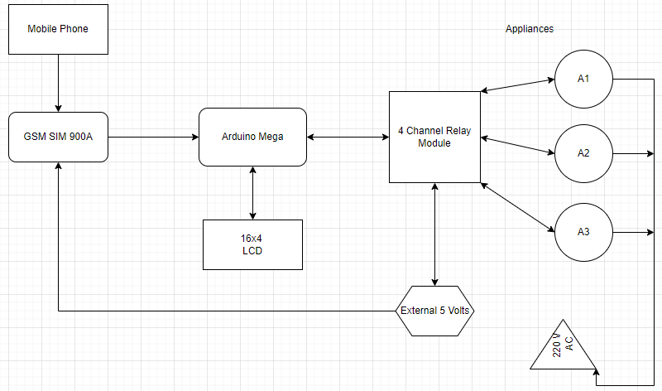

Slide 38
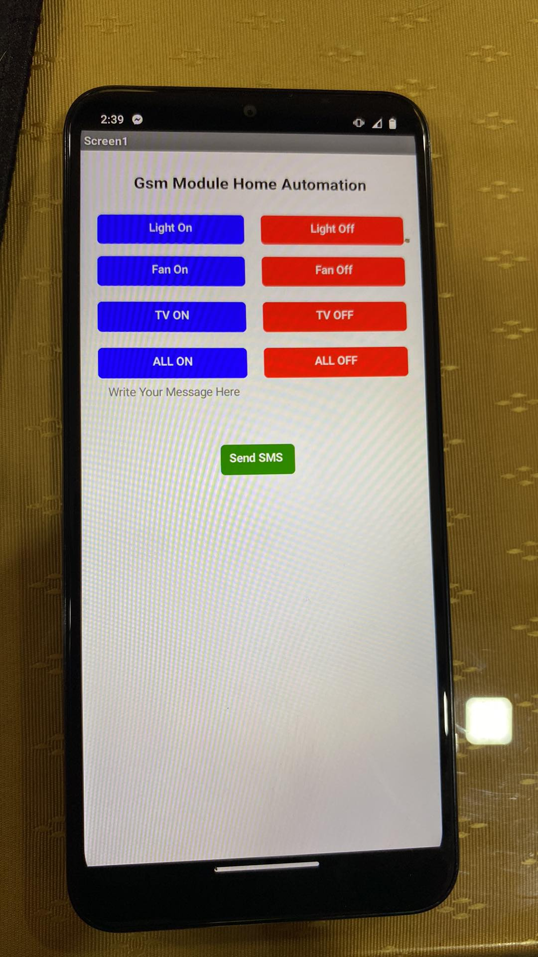
Remote
The Researcher use the mobile phone as a
Remote control.

Slide 39


Slide 40
INTEGRATE EXISTING WEB APPLICATION FOR HOME APPLIANCE CONTROL

Slide 41
INTEGRATE EXISTING WEB APPLICATION FOR HOME APPLIANCE CONTROL
The web application is the App Inventor.
This web application features a visual smartphone wherein the researchers design a phone application to control appliances through mobile phones.
It comprises 4 sets of on and off remote buttons for the three home appliances and one selection for switching all appliances.

Slide 42


Slide 43
INTEGRATE EXISTING WEB APPLICATION FOR HOME APPLIANCE CONTROL
For the construction of the phone application, the building blocks feature of the App Inventor for the visualization of the construction of the syntax.
It includes setting up the given mobile number, conditions set through each home appliance, and button functions.

Slide 44
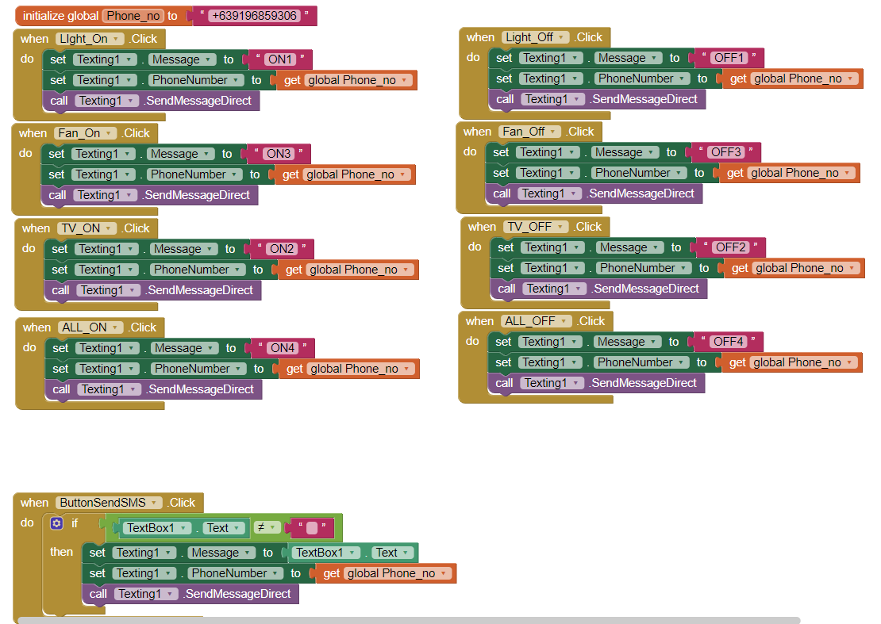

Slide 45
OTHER FEATURES OF THE SYSTEM

Slide 46
OTHER FEATURES OF THE SYSTEM
Scheduling timer
The user will use the push button switch to specify the time for the appliances to automatically turn on/off at the specified time.
Temperature Monitoring of the switchbox
The RTC data were retrieved from the RTC using a standard command from the DS3231 Library.

Slide 47
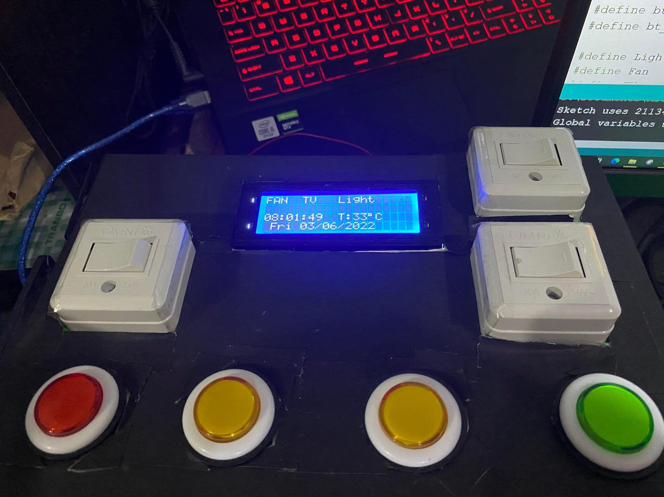

Slide 48
CHAPTER 5 SUMMARY, CONCLUSION, AND RECOMMENDATION

Slide 49
S U M M A R Y
Through the phase of planning and building the system the researchers have obtain the following:
Learned how to make a remote control phone application
Learned how to test microcontroller programs to control various appliances.
Make additional feature for the system.
Learned how to operate with SMS technology.
Enhanced knowledge in electronic components.
Improved writing skills and learning methods.
Learn the process of proper documentation methods while writing this thesis.

Slide 50
C O N C L U S I O N
The GSM-Based Home Automation Using Arduino includes an Arduino Mega board, GSM Module, a mobile device, electrical and other electronic components, and home appliances.
It is both user-friendly, accessible, and economical. Furthermore, it can be determined that this project's requirements are fulfilled.

Slide 51
R E C O M M E N D A T I O N
Requires further evaluation to determine how to improve the home automation system.
Controls such as speed of the fan and the brightness of lights and other control.
Building a utility mobile application.
Advanced security measures to minimize infiltrating the system
Switchbox improvement supporting strength, longevity and compactability of the system.

